Slide 1
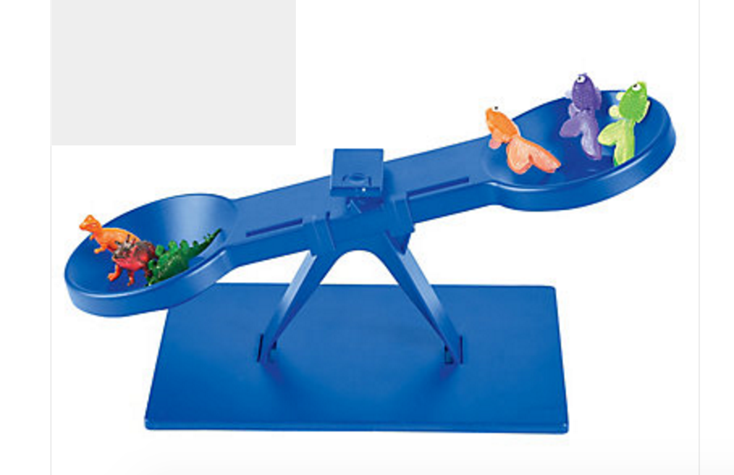
Swallowing and QOL Scales
http://www.orientaltrading.com/

Slide 2
Penetration-Aspiration Scale
Material does not enter the airway
Material enters the airway, remains above the vocal folds, and is ejected from the airway
Material enters the airway, remains above the vocal folds, and is not ejected from the airway
Material enters the airway, contacts the vocal folds, and is ejected from the airway
Material enters the airway, contacts the vocal folds, and is not ejected from the airway
Material enters the airway, passes below the vocal folds, and is ejected into the larynx or out of the airway
Material enters the airway, passes below the vocal folds, and is not ejected from the trachea despite effort
Material enters the airway, passes below the vocal folds, and no effort is made to eject

Slide 3
Dysphagia Outcome and Severity Scale (DOSS)
Level 7: Normal in all situations
Level 6: w/i functional limits/modified independence
Level 5: Mild dysphagia: distant supervision; may need one diet consistency restricted
Level 4: Mild-moderate dysphagia: intermittent supervision/cueing; 1-2 diet consistencies restricted
Level 3: Moderate dysphagia: total assist, supervision, or strategies; 2 or more diet consistencies restricted
Level 2: Moderately severe dysphagia: maximum assistance or maximum use of strategies with only partial po intake
Level 1: Severe dysphagia: NPO: Unable to tolerate any po safely

Slide 4
Performance Status Scale for Head & Neck Cancer: PSS-HN
Normalcy of Diet
Feeding Tube
Public Eating
Understandability of Speech

Slide 5
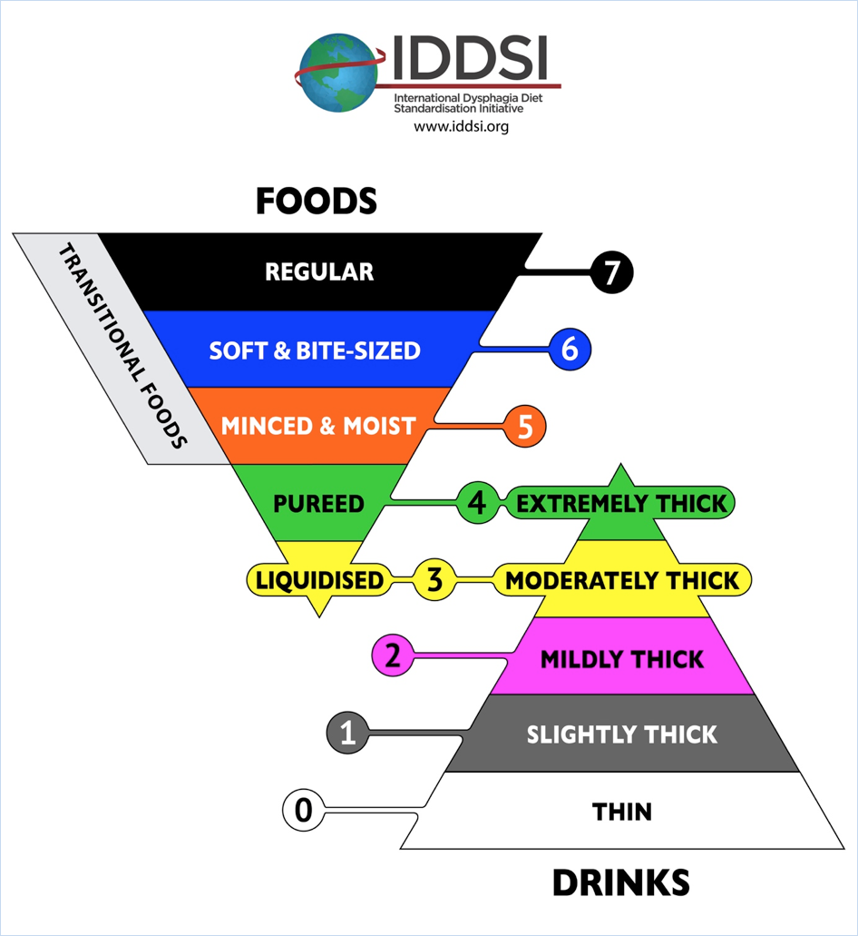
PSS-HN: Normalcy of Diet
100 Full diet no restrictions
90 Dull diet (liquid assist)
80 All meat
Raw carrots, celery
Dry bread and crackers
Soft chewable foods
40 Soft foods requiring no chewing
30 Pureed foods (in blender)
Warm liquids
Cold liquids
0 Non-oral feeding (tube fed)

Slide 6
PSS HN: Tube feeding
Use of feeding tube – number of cans per day
1= liquids only
2=supplements oral intake
3=sole source of nutrition

Slide 7
PSS-HN: Public Eating
No restriction of place, food, or companion
No restriction of place, but restricts diet when in public
Eats only in presence of selected persons in selected places
Eats only at home in presence of selected persons
0 Always eats alone

Slide 8
PSS-HN: Understandability of Speech
  Always understandable
  Understandable most of the time; occasional repetition necessary
  Usually understandable; face to face contact necessary
  Difficult to understand
  0 Never understandable; may use written communication

Slide 9
CA tumor staging
TNM staging
Tumor (T) refers to the primary tumor
  Ranked from 0 to 4
N represents regional lymph node involvement
  Ranked from 0 to 4
M represents metastasis
  0 = no metastasis has occurred
  1 = metastases are present
T3N1M1

Slide 10
Quality of Life (QOL) Scales
Quality of Life from a pts perspective
SWAL-QOL (McHorney, Robbins 2003)
  Self-administered questionnaire designed specifically for evaluating the impact of dysphagia on the QOL of patients with oral pharyngeal dysphagia
  https://lmholtanslp.files.wordpress.com/2013/02/quality-of-life-in-swallowing-disorders-swal-qol.pdf
  M.D. Anderson Swallowing Inventory
  Self-administered questionnaire designed specifically for evaluating the impact of dysphagia on the QOL of patients with head and neck cancer
  https://www.baylorhealth.com/SiteCollectionDocuments/Documents_All%20Saints/BIR%20pages/The%20MD%20Anderson%20Dysphagia%20Inventory.pdf

