Slide 1

Respiration (breathing) and aspiration
Christine Sapienza
U of FL

Slide 2
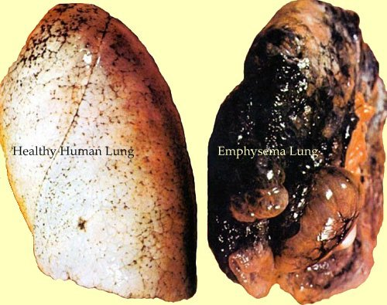
Cigarette anyone?
webpages.csus.edu/~la634/

Slide 3
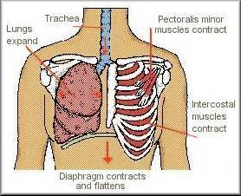
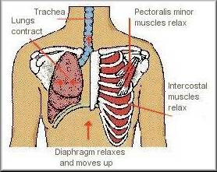
Predominate patterns in adults
  Normal swallows followed by exhalation regardless of bolus size
    Exhale-swallow-exhale (80% of swallows)
    Inhale-swallow-exhale (20% of swallows)
  Dysphagic swallows more likely to
    Exhale-swallow-inhale
    Inhale-swallow-inhale
inhale
exhale
http://www.trainair.co.uk/images/inhale.jpg

Slide 4
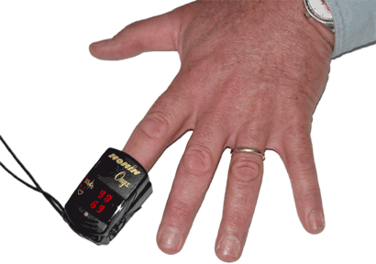
O2 Saturation
Pulse oximeter
  Measures oxygen saturation
  Normal O2 > 90
Changes in O2 sats
  Cough, eating, breath holding, physical exertion
No clear relationship between O₂ and aspiration
(Sellars,et al., 1998)
http://unmc.edu/nursing/careers/images/Pulse-Oximeter.gif

Slide 5
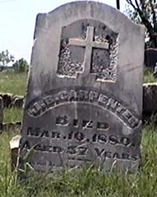
Respiratory compromise
Pneumonia
  5th leading cause of death age 60+ years
  3rd leading cause of death age 80+ years
http://images.google.com/imgres?imgurl=http://www.hhjm.com/rally/FortsTrailVideo/tombstone.jpg&imgrefurl=http://www.hhjm.com/rally/FortsTrailVideo/&h=234&w=187&sz=15&tbnid=zcepVDJrNjIJ:&tbnh=104&tbnw=83&hl=en&start=1&prev=/images%3Fq%3Dtombstone%26svnum%3D10%26hl%3Den%26lr%3D%26rls%3DGGLD,GGLD:2005-16,GGLD:en

Slide 6
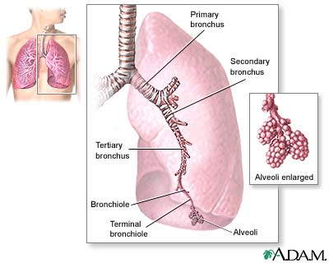
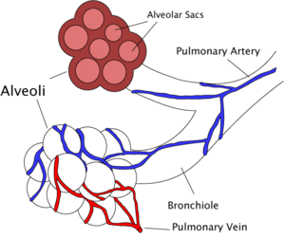
Pneumonia
Infection of alveoli as oppose to bronchi, bronchioles or upper airway
Occurs in all ages
  Especially very young
  and very old
  Common cause of death
  and hospitalization

Slide 7
How pneumonia is acquired
Community acquired (CAP)
  85% of CAP are bacterial
  15% Mycoplasma, Chlamydia, Legionella
Nosocomial (Hospital acquired)
  More serious 2⁰ to immunosuppression
  Risk factors-immunosuppression, ETOH, medication, young/old age, recent illness, aspiration
  Can increase length of stay by ~7-9 days $2696 x 7= $18,872
Aspiration
  Prandial, non-prandial
  Risk factors-dysphagia, dental problems, sedative drugs, anesthesia, coma, ETOH

Slide 8
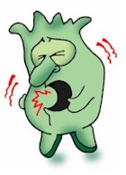
Types of pneumonia
Bacterial
  Aspiration pneumonia is typically bacterial
Viral
  1 in 100 people/year
  Usually mild, pts heal w/o treatment
    Herpes, immunocompromised, AIDS, transplants
Mycoplasma
  Mycoplasmas=smallest free-living agent of disease
  Not virus or bacteria, but has characteristics of both
Fungal
  Pneumocystis carinii pneumonia (PCP)
    Immunocomprimised
    70% of AIDS pts will develop PCP
http://www.mercola.com/images/blog/2004.07.06.cough.jpg

Slide 9
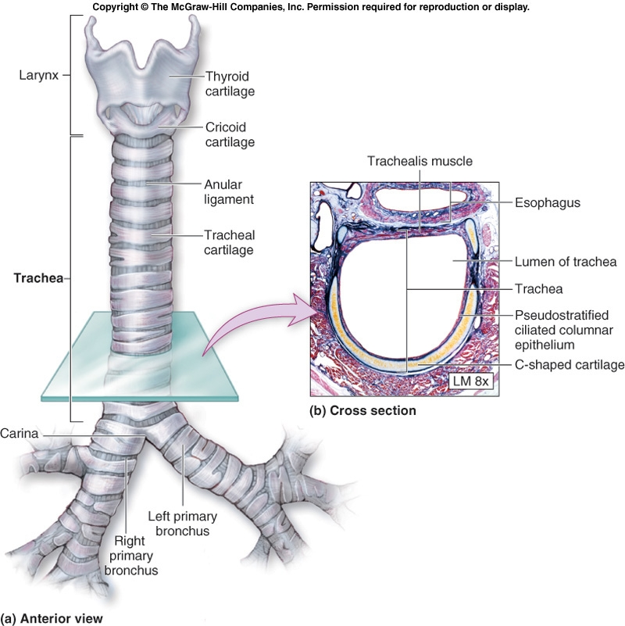
Right lung-3 lobes
Left lung-2 lobes
http://academic.kellogg.edu/herbrandsonc/bio201_mckinley/f25-7a-b_trachea_anteri_c.jpg

Slide 10
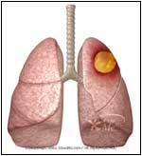
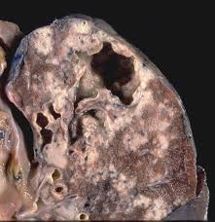
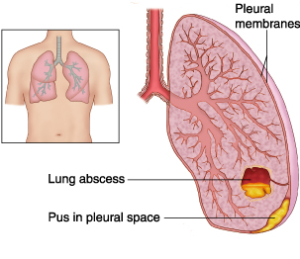
Aspiration pneumonia
Serious pulmonary complications
  Lung abscess
    slow, insidious presentation and usually develop 1-2 weeks after the initial aspiration event.
  Lung necrosis
  Empyema (ĕm'pī-ē'mə)
    a collection of pus in the pleural space (the cavity between the lung and the membrane that surrounds it
  Adult respiratory distress syndrome
  Death
beltina.org
biologyimagelibrary.com
mdguidelines.com

Slide 11
Aspiration in adults
~50% of adults aspirate small amounts of saliva in their sleep
Complications from aspiration rare in healthy adults due to adequate bronchopulmonary clearance
  Cough
  Airway cilia network
  Interstitial (btwn cells) lymphatics
  Alveolar macrophages
  Local immunoglobulins

Slide 12
Dysphagia and aspiration are necessary, but not sufficient conditions for the development of aspiration pneumonia
Langmore et al. 1998

Slide 13
Risk factors for aspiration pneumonia
Health status
Dependent feeders Langmore et al., 1998
Tube feeding
  Reflux, regurgitation, oropharyngeal secretions
**SLPs-one of our roles is to predict a pts risk for aspiration Sullivan, 2004

Slide 14
Chief Determinants in aspiration pneumonia Sullivan, 2004
Frequency of aspiration
Character of aspirate
  Volume
  Acidity
  Chemical composition
Presence of particulate matter, food, bacteria
Frequently presents in right lower lobe

Slide 15
Timing of Aspiration
Before the swallow (pre-parandial)
During the swallow (parandial)
After the swallow (post-parandial)
    3-R’s
  Residue
  Reflux
  Regurgitation

Slide 16
8-Point Penetration-Aspiration Scale Rosenbek et al. 1996
Score Description of Events
1. Material does not enter airway
2. Material enters the airway, remains above the vocal folds,
and is ejected from the airway.
3. Material enters the airway, remains above the vocal folds,
and is not ejected from the airway.
4 Material enters the airway, contacts the vocal folds,
and is ejected from the airway.
5. Material enters the airway, contacts the vocal folds,
and is not ejected from the airway.
6. Material enters the airway, passes below the vocal folds,
and is ejected into the larynx or out of the airway.
7. Material enters the airway, passes below the vocal folds,
and is not ejected from the trachea despite effort.
8. Material enters the airway, passes below the vocal folds,
and no effort is made to eject.

Slide 17

3 oz water swallow test (Suiter & Leder 2008)
Drink 3 oz H20 without interruption
  From cup or straw
Pass (can drink & no cough/choke for 1 minute)►Pt safe for thin liquids
  (97.9% confidence)
Fail ►further evaluation??? (over refers)
  (45% aspirating; 55% not aspirating)
andybrain.com

Slide 18
Lab
Name of pneumonia on back
  Yes/No questions only
  Can only ask one ? Per person
  Cannot ask questions with the following words: Community acquired pneumonia, nosocomial, aspiration

