Slide 1
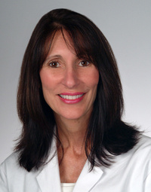
The Normal Swallow
(view MBS)
Bonnie Martin-Harris MUSC

Slide 2
3 Stages or phases of swallowing
Swallowing
One continuous act
Can be divided into 3 interdependent stages (Logemann)
  Oral (includes oral/preparatory as discussed in Logemann)
  Pharyngeal
  Esophageal

Slide 3
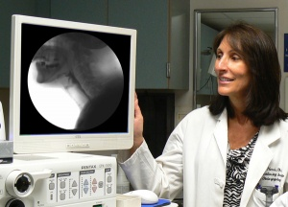
MBSImp
(Martin-Harris et al. 2008, 2010)
Standardized measurement tool for interpreting MBS
No stages
Reported as
  Oral impairment
  Pharyngeal impairment
  Esophageal impairment
Moving Toward Standardizing Dysphagia
Practice: Introducing The Modified Barium
Swallow Impairment Profile (MBSImP)
http://www.northernspeech.com/seminar_detail/1000118/Assessment_Tests__Screening_Tools/1001231/The_Modified_Barium_Swallow_Impairment__Profile_MBSImP__A_Standardized_Assessment_and_Treatment__Planning_Protocol/

Slide 4
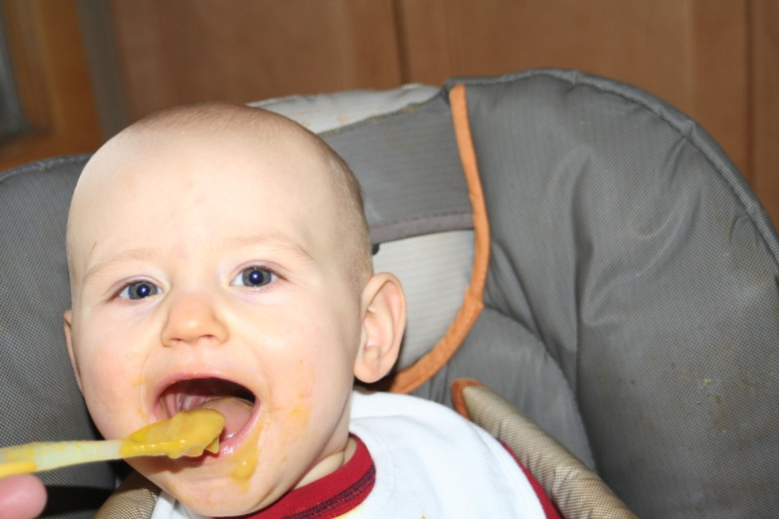
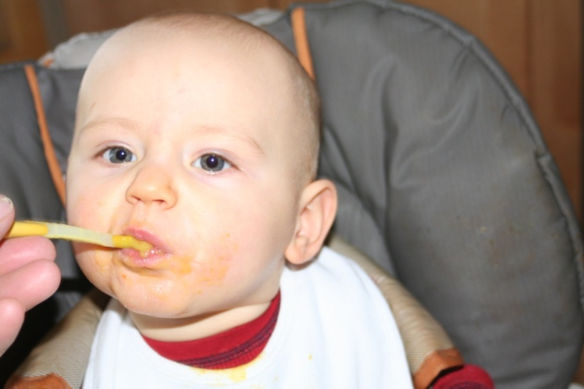
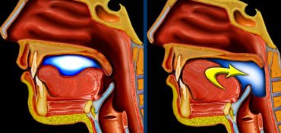
Oral observations
Food enters mouth
Lip closure
Tongue gathers bolus
http://www.radiologyassistant.nl/images/thmb_44297df2c4541oral1+2.jpg

Slide 5
Oral/preparatory stage description
Preparation of food boluses in the oral cavity
Ends when the bolus is gathered into a cohesive unit
Before the swallowing response
Tongue moves bolus laterally
Chewing (first stage of deglutition) reduces bolus size
Tongue dorsum elevation prevents liquid and solids from prematurely entering the airway

Slide 6
Oral/preparatory stage muscles
Paired muscles used in chewing
Temporalis -CN V (trigeminal)
Masseter -CN V (trigeminal)
Buccinator -CN V (trigeminal)
Pterygoid -CN V (trigeminal)

Slide 7
Oral/preparatory stage soft tissue
Lips
Tongue
Cheeks
  Sulci
Salivary glands

Slide 8
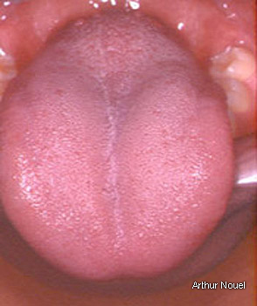
Tongue
Tip
Blade
Dorsum
Root or base of tongue (BOT)
Median groove or central groove
Papillae

Slide 9
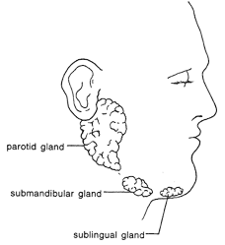
Salivary glands
Parotid
  Serous fluid
    Thinner
    More watery
Submandibular
  Mostly serous fluid
  Some mucus
Sublingual
  Mostly mucus
  Some serous
http://www.entnet.org/healthinfo/throat/salivary.cfm

Slide 10
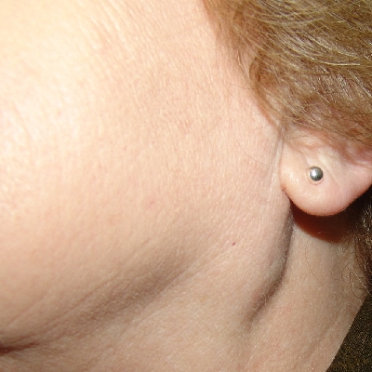
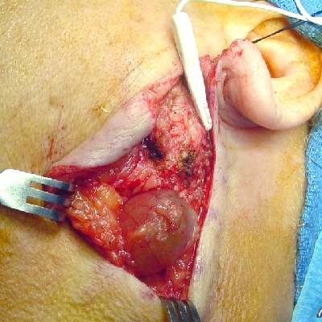
Parotid gland tumor
Parotid gland produces serous fluid
http://www.ghorayeb.com/ParotidCyst.html

Slide 11
Function of saliva
Maintain oral moisture
Reduce tooth decay
Assist in digestion
Natural neutralizer of stomach acid from esophageal reflux
Production of saliva is triggered by chewing

Slide 12
Oral/preparatory stage nerves
Salivary glands innervation (sensory)
  CN VII (facial)-sublingual and submandibular
  CN IX (glossopharyngeal)-parotid
Tongue, teeth, gums, palate (sensory)
  CN V (trigeminal) –mechanical pressure sensors
  CN V (trigeminal) –change in temperature
  CN VII (facial) –chemo-receptors for taste
    anterior 2/3 of tongue
  CN IX (glossopharyngeal) –chemo-receptors for taste
    posterior 1/3 of tongue

Slide 13
Oral/preparatory stage central control
Higher cortical centers
  Capable of initiating and terminating a swallow
Medulla (brainstem)
  Nucleus tractus solitarius (NTS)
    Receives information from sensory branches of CN
    Taste
    Temperature
    Mastication

Slide 14
Oral stage - a.k.a. oral pharyngeal stage
Soft palate closes off nasal cavity
Hyoid bone begins to move up and forward
Tongue propels bolus back
http://www.radiologyassistant.nl/images/thmb_44297df2c4541oral1+2.jpg

Slide 15
Oral stage description
Begins after the bolus is gathered and prepared for swallowing
Tongue cradles bolus
  Presses edges against hard palate
Tongue propels bolus posteriorly
Posterior pharyngeal wall moves anteriorly
Hyoid bone begins to elevate and move anteriorly
Velum elevates
Airway begins to close

Slide 16
Oral stage nerves & muscles
Tongue –Extrinsic tongue muscles cradle bolus
  Genioglossus (CN XII Hypoglossal)
    comes from the genial tubercule of the mandible
    comprises most of the bulk of the tongue.
  Hyoglossus (CN XII Hypoglossal)
    attached to the hyoid bone
  Styloglossus (CN XII Hypoglossal)
    comes from the styloid process of the temporal bone
  Palatoglossus (CN XI Accessory & CN X Vagus) connects the soft palate to the tongue
    forms the bulk of the anterior of two arches that delineate the oral cavity from the oropharynx.

Slide 17
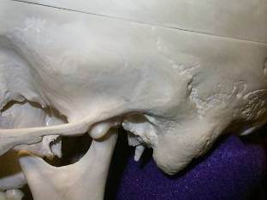
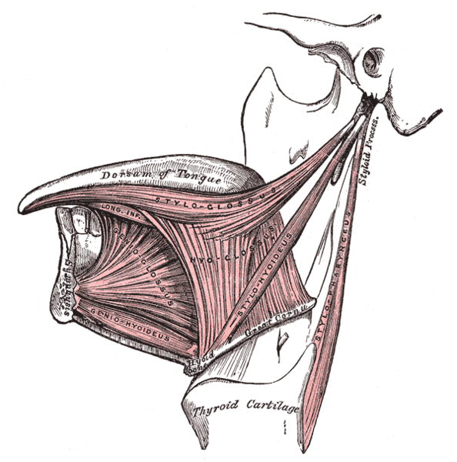
http://en.wikipedia.org/wiki/File:Gray1019.png

Slide 18
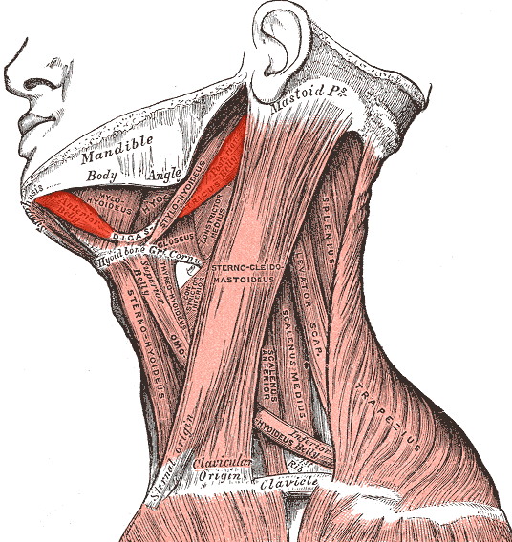
Oral stage nerves & muscles
Tongue –Extrinsic tongue muscles propel bolus posteriorly
  Digastric (CN V Trigeminal)
  Myohyoid (CN V Trigeminal)
  Geniohyoid (CN XII Hypoglossal)

Slide 19
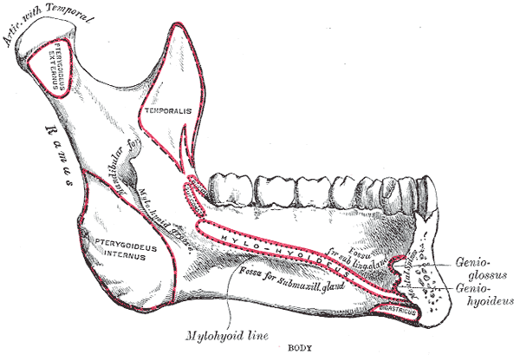
http://en.wikipedia.org/wiki/File:Gray1019.png

Slide 20
Oral stage nerves & muscles
Tongue –Posterior elevated
  Palatoglossus (CN X Vagus)
Velum elevation
  Palatopharyngeal (CN X Vagus & CN XI Accessory)
  Levator veli palatini (CN X Vagus & CN XI Accessory)
  Tensor veli palatini (CN V Trigeminal)

Slide 21
Oral stage nerves & muscles
False and true vocal folds -airway closure (motor)
  CN X Vagus
    recurrent branch
Mechanical, chemical, and water respondent receptors (sensory)
  CN X Vagus
    superior laryngeal nerve

Slide 22
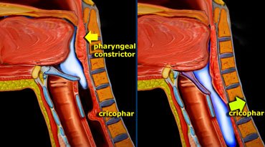
Pharyngeal stage
Trigger pt
  Maintained elevation
  Epiglottis partially covers airway
  Larynx raises 2-3 cm
  UES opens
  Pharynx shortens
http://images.google.com/imgres?imgurl=http://www.radiologyassistant.nl/images/thmb_44299de5ccc67pharyngeal1%2B2.jpg&imgrefurl=http://www.radiologyassistant.nl/en/440bca82f1b77&h=205&w=370&sz=24&hl=en&start=73&um=1&tbnid=XtdH_wPZMkUptM:&tbnh=68&tbnw=122&prev=/images%3Fq%3Dpharyngeal%2Bstage%26start%3D72%26ndsp%3D18%26um%3D1%26hl%3Den%26rlz%3D1T4GGLR_enUS247US248%26sa%3DN

Slide 23
Pharyngeal stage description
Begins when bolus passes the trigger point (arbitrary location) and enters pharynx
Velum remains elevated, airway remains closed
Hyoid bone elevation and anterior position maintained
Pharynx shortens
Larynx moves up (2-3 cm) under tongue
Epiglottis folds down over airway
UES opens

Slide 24
Pharyngeal stage nerves & muscles
Elevate and shorten pharynx as bolus arrives
  Palatopharyngeal (CN X Vagus & CN XI Accessory)
    pulls the walls of the pharynx superiorly, anteriorly and medially during swallowing
  Stylopharyngeus (CN IX Glossopharyngeal)

Slide 25
Pharyngeal stage nerves & muscles
False and true vocal folds -airway closure
  Should occur during oral/pharyngeal stage but reported as pharyngeal stage
  CN X Vagus
    recurrent branch

Slide 26
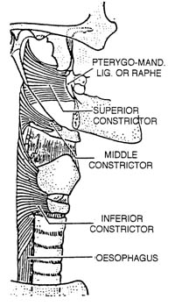

Pharyngeal stage nerves & muscles
Relax during swallow
Form outer layer of the
anterior wall of pharynx
Posterior pharyngeal wall moves anteriorly
  Superior constrictor (CN X Vagus & CN XI Accessory)
  Middle constrictor (CN X Vagus)
  Inferior constrictor (CN X Vagus & CN XI Accessory)
http://www.emory.edu/ANATOMY/AnatomyManual/pharynx.html

Slide 27
Inferior constrictor muscle
Relaxes during swallow
Two parts
  Thyropharyngeus
  Cricopharyngeus (AKA Upper esophageal sphincter or UES)

Slide 28
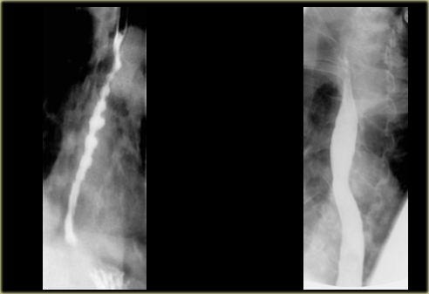
Esophageal stage
http://www.radiologyassistant.nl/en/472458f15c55a

Slide 29
Esophageal description
At rest esophagus
  Closed muscular tube
  18-22 cm (8-10 inches)
  Enters stomach through the diaphragmatic hiatus
  UES-superior boundary
  Lower esophageal sphincter (LES)-inferior boundary

Slide 30
Esophageal stage description
Peristalsis delivers bolus from proximal to distal esophagus (3-10 sec)
First contractile wave is strongest
More efficient the pharyngeal clearance the stronger the wave
Multiple swallows of the same bolus may inhibit peristalsis
Secondary peristaltic wave signals LES to open

Slide 31
Esophageal stage nerves and muscles
Esophagus
  Upper 1/3 is striated muscle
    CN X Vagus from nucleus ambiguus
  Middle 1/3 mixed striated and smooth muscle
  Lower 1/3 is smooth muscle
    CN X Vagus from dorsal motor nucleus

Slide 32
Normal swallow

Slide 33
Central control of swallow
“Swallow Center” (NTS+NA)
  Located in the medulla of the brainstem
NTS (Nucleus tractus solaritus or nucleus of the solitary tract )
  Integrates sensory info of touch, sense, taste
  Afferent input from CN V, VII, IX, X
  Afferent input from cardiovascular and respiratory brainstem nuclei
  Transfers sensory information to NA

Slide 34
Central control of swallow
NA (Nucleus ambiguus)
  Integrates and coordinates motor output to the swallowing muscles
  Via CN V, VII, IX, X, XI, XII

Slide 35
Central control of swallow
NTS communicates with
  Hypothalamus
    Hunger and thirst
  Sensory motor strip in parietal lobe
  Precentral cortex
  Lateral postcentral gyrus
  Supplementary motor area
  Limbic forebrain
  Cerebellum

Slide 36
Rapid transfer of the bolus in a normal swallow
Oral cavity to pharynx (liquids)
  .05-1 second
Oral cavity to stomach (liquids)
  <5 seconds
High pressure on bolus
Negative pressure below level of bolus
  Esophagus remains (-) pressure

Slide 37
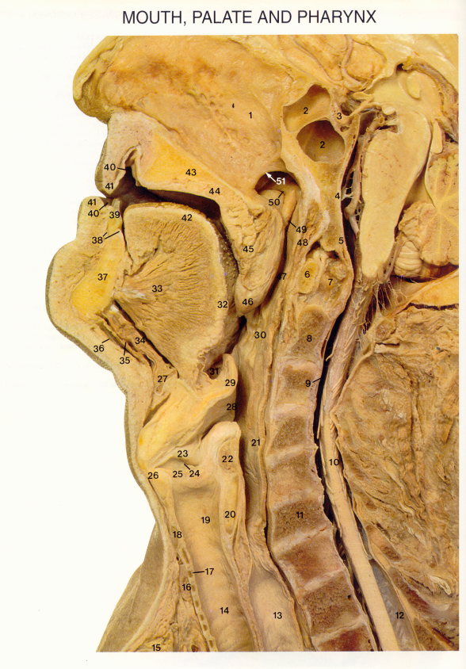
Creating zones of high and low pressure
Accomplished by coordination and strength of swallowing valves.

Slide 38
Valves
Lips
  Closure builds intraoral pressure
Velum
  Seals nasopharynx from foreign matter
Tongue dorsum
  Seals oral cavity from pharyngeal reflux during swallow
False vocal folds (vf)
  Protects airway

Slide 39
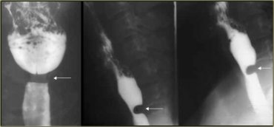
Valves
True vocal folds
  Protects airway
Upper esophageal sphincter (UES) a.k.a. pharynoesophageal (PES) or cricopharyngeus (CP)
  Relaxes for bolus entry
  Closes to avoid regurgitation
Lower esophageal sphincter (LES)
  Relaxes for bolus entry
  Closes to avoid reflux
Cricopharyngeal achalasia (abnormal)

Slide 40
Mechanism of UES opening
Mechanical traction
Posterior tongue retraction
Hyoid bone elevation
Hyoid bone elevates the thyroid and cricoid cartilages
Bolus
Driving
force
Brainstem
disinhibition

Slide 41
Mechanisms of airway protection during swallowing
Airway closure
  True and false vocal folds adduct
  Laryngeal aditus narrows
Laryngeal elevation
  Larynx raises and tilts under base of tongue
Tongue base retraction
  Posterior tongue action deflects bolus away from airway

Slide 42
Mechanisms of airway protection during swallowing
3. Epiglottis inverts
  Rising larynx and thyroepiglottic ligament contraction allows epiglottis to fold over the laryngeal aditus
4. Vallecular spaces
  Bolus divided and channeled around airway

Slide 43
Valves create a series of positive and negative pressures
Pharyngeal phase
  Tongue base & pharyngeal constrictors
    (+) pressure on bolus as it flows into (-) pressure in pharynx
    (-) pressure aids in UES opening
Esophageal phase
  Peristalsis
    applies (+) pressure
    Esophagus is a (-) pressure structure
    The bolus is both pressed down by peristalsis and sucked down via (-) pressure

Slide 44
Respiration and Swallowing

Slide 45
Apneic period
Airway closure period
No respiration
Duration increases as bolus volume increases
75% of normal swallows begin with exhalation and typically followed by continued exhalation
Dysphagic pts more likely interrupt inhalation to swallow

Slide 46
Variations in Normal Swallow

Slide 47
Volume effects
Larger bolus volumes preceded by inhalation
Small bolus (5 ml)
  Oral phase followed by pharyngeal phase
Large bolus (10-20 ml)
  Simultaneous oral and pharyngeal phases
    Needed to safely clear bolus
  Tongue base and pharyngeal wall movement occurs later

Slide 48
Increase in viscosity
Pressure of tongue and pharyngeal walls increase
Valve functions increase in duration
  Velar closure
  Laryngeal closure
  UES opening

Slide 49
Swallow Review
All normal swallows include
  Oral propulsion of the bolus into the pharynx
  Airway closure
  PES/UES opening
  Tongue base-pharyngeal wall propulsion to move bolus from pharynx into the esophagus

