Slide 1

Clinical swallow
Part II
Stephanie Daniels, U of Houston with Doreen Nicholas, EWU

Slide 2
Signs and symptoms of dysphagia

Slide 3
Signs and symptoms of dysphagia
(What to look for during screening)
Patient complains of difficulty swallowing
Difficulty in placing food in mouth
Inability to control food or saliva
Coughing before, during, or after swallow
Recurrent Pneumonia
Weight Loss
Gurgly voice quality
Increased secretions after swallow
Inability to recognize food

Slide 4
Clinical swallow examination (CSE) aka Bedside eval

Slide 5
Indications for CSE
For any pt. referred for an assessment of suspected swallowing problem
1st step for Dx and Tx process
Provides info regarding symptomatology
Determines readiness further Dx tests

Slide 6
Advantages of CSE (Zenner, 2000)
As compared to MBS/VFSS
  Less invasive
  Less taxing on frail pts
  Provides a more ecological evaluation in a more typical setting
More readily available
Incorporates variables that determine prognosis and Tx direction

Slide 7
Limitations of CSE
Cannot visualize the entire alimentary tract
Cannot provide definitive info
  Whether a pt. is aspirating
  Why a pt is aspirating
NOT a substitute for “gold standard” VFSS

Slide 8
Silent Aspiration
Pt does not exhibit signs or symptoms (s/s) of aspiration
Over 50% of pts who aspirate DO NOT cough

Slide 9
Components of the CSE
Medical Hx
  Pt, family, caregiver interview
Oral motor exam
  Structure
  Function
Observation of swallowing
  Dry swallow
  Liquids (not always part of a CSE)
  Solids (not always part of a CSE)

Slide 10
CSE variations based on medical setting
Acute care
  Oral motor assessment
  Whether or not to include food or water swallows is decided pt by pt
Rehab setting
  Oral motor assessment
  Different consistencies of solids and liquids often attempted if pt is an oral feeder (p.o.)

Slide 11
Equipment for CSE
Flashlight
Tongue depressor
Gloves
Small laryngeal mirror
Emesis basin
Tissue or towel
Suction
Gauze
Feeding apparatus (spoon, cup, straw)
Food and liquid of different consistencies
Lemon juice, sugar water, saline (different bolus tastes)

Slide 12
Challenges of a medical (case) Hx
Dysphagia often is a long-standing disorder
  Pts adept at compensating
Medical record does not document a clear picture of dysphagia
Dysphagia is a symptom of other medical disorders

Slide 13
Medical Hx interview
Chief complaint
Pt perception of problem
Character of complaint
  Food consistency
  Frequency and timing
  Pain with swallowing (odynophagia)
  Globus (lump or feeling of food sticking in throat)

Slide 14
Medical Hx interview
Course of complaint
  Sudden onset
  Slow progression
  intermittent
Activities of Daily Living (ADL’s)
  Independent
  Dependent *
Previous Tx
  Compliance
  Adequate

Slide 15
Medical Hx interview
  Ask ?s about each stage of swallow
  Consider for multiple etiologies
  Surgical Hx
  Neurological disease
    Greatest number of pts (40%) with dysphagia
    Ask about changes in
      Motor skills
      Speech
      Loss of sensation
      Coordination

Slide 16
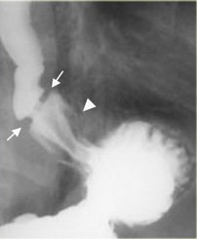
Other risk factors for dysphagia
Side effects of medications
  Xerostomia
  Stricture formation
Bacterial, viral, fungal infections
  TB, herpes, AIDS, Guillane-Barre
Toxins
  Lead, botox, alcohol
Diabetes mellitus (type II)
  Peripheral nerve damage
  Esophageal dysmotility

Slide 17
Other risk factors for dysphagia
Respiratory disease
  COPD (chronic obstructive pulmonary disease)
  Asthma
    Aspiration may mimic asthma
  Hx of pneumonia
  Increased respiration rate during or after eating
  Choking

Slide 18
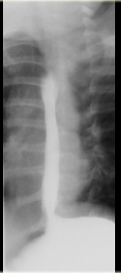
Other risk factors for dysphagia
Esophageal disease
  May affect oral and pharyngeal stages
  Prior dilation
  Hiatal hernia
  GI bleed
  Reflux and regurgitation
    Heartburn, chest pain during or after eating, acid taste, hoarseness, persistent/unexplained cough
http://www.radiologyassistant.nl/en/472458f15c55a

Slide 19
Structure-function exam
(aka oral motor, oral pharyngeal, oral peripheral exam, OPE)

Slide 20
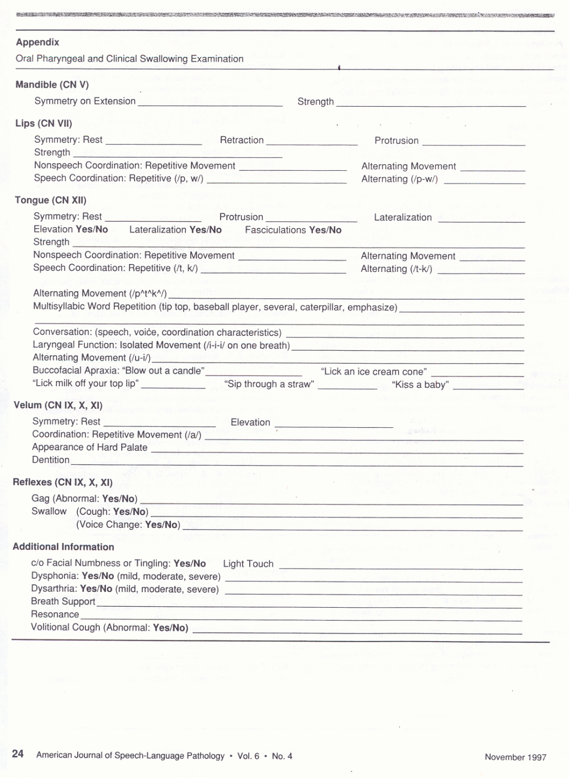
Oral motor exam form (Daniels, 1997)
Complete this exam on 2 different “pts” one in class & one outside of class

Slide 21
Check gag reflex (optional)
Use tongue depressor or laryngeal mirror
  Posterior tongue (dorsum)
  Velum
  Faucial pillars
  Posterior pharyngeal wall
Gag reflex
  an indication of airway protection
  Clinically significant if absent on one side but not the other
  NOT an indication of intact swallow

Slide 22
When liquid or solids are incorporated into a CSE
Place hand in “dysphagia hand shake” position
Initiation of tongue movement-initiation of hyoid laryngeal elevation <1 sec.
Phonate “ah” immediately after swallow
  Check for wet voice quality
If wet-swallow additional times
  Check for wet voice quality
If wet-pant several times to clear residual
  Check for wet voice quality

Slide 23
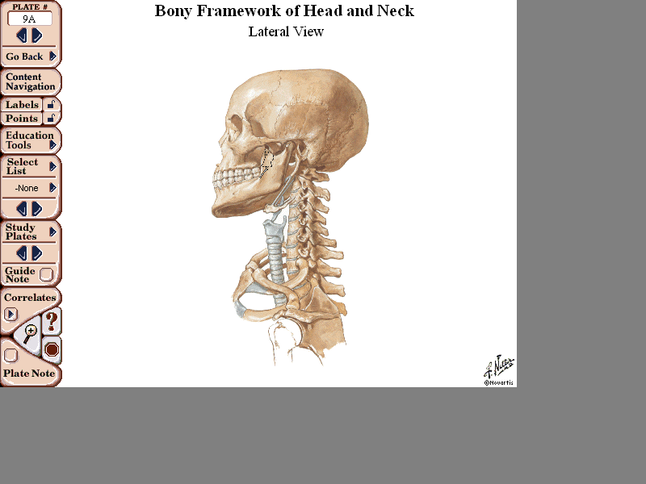
Bedside or clinical swallow study
Pointer
underside of chin
Tall man
hyoid bone
Ring man
laryngeal notch (top of larynx or Adam’s apple
Pinky
bottom of larynx

Slide 24
Residual terminology
  Residual/Residue
    Solids/liquids in oral sulci after swallow
      Formerly referred to as pocketing
    Solids/liquids in valleculae or pyriform sinuses
      Formerly referred to as pooling
    Coating of solids/liquids on tongue base (BOT) or posterior pharyngeal wall (PPW)

Slide 25
Check for residual in sinuses
Turning head may squeeze residual from sinuses
  In the valeculae
    Lift chin up and hold for 3 sec.
    Check for wet voice quality
  In the pyriforms
    Turn chin to right
    Check for wet voice quality
    Turn chin to left
    Check for wet voice quality

Slide 26
Aspiration indicators
Wet voice
Cough
Throat clear
Expectorates material
Remember: 50-60% of patients who aspirate are silent aspirators

Slide 27
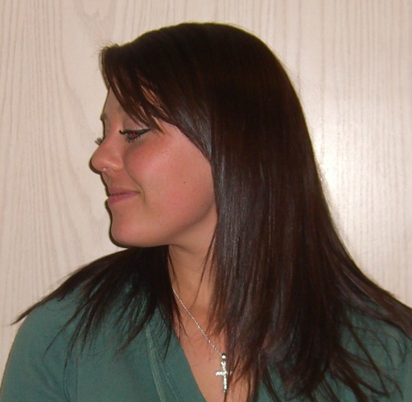
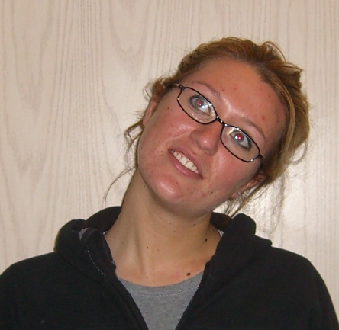
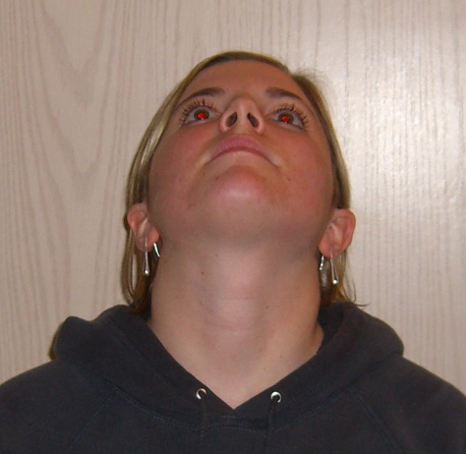
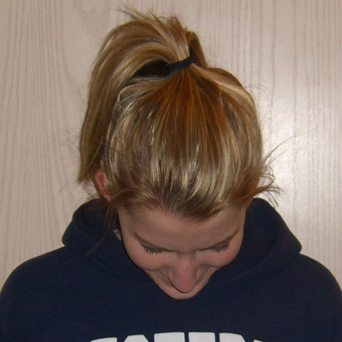
Compensatory Strategies: Postural Techniques
Narrows airway entrance
Pushes tongue base towards pharyngeal wall
Increases airway protection
Uses gravity to clear the oral cavity
Minimizes drooling
Head Turn
Head Tilt
Increases vocal fold closure
Narrows airway entrance
Maximizes undamaged side of pharynx
Maximizes muscles and posterior wall peristalsis on good side
Head Back
Chin Tuck

Slide 28
Swallow Maneuvers
Effortful swallow – squeeze all muscles and swallow Increases posterior movement of BOT
Supraglottic – hold breath Closes airway before and during swallow
Supersupraglottic – hold breath + bear down/squeeze Closes airway before and during swallow
Mendelsohn – hold larynx up 3-5 seconds after swallow Helps keep UES open
Tongue hold exercise (Masako) – use sterile gauze or pt’s tongue
Increases posterior movement of BOT

